Slide 1
Design documentation

Slide 2
What is a design pack?
In this section you need to "design" how the whole system will look / work / store data etc.
WITH ALL of your thoughts / decisions recorded and justified
Your designs need to be detailed enough that you could give your design pack to someone else and they should be able to build what you have envisioned.

Slide 3
Organisation of your designs
There is no set order to a design section,
Order them how you feel works for you
Just remember to have commentary of your decisions and reasoning (linked to the functional and non-functional criteria you have identified

Slide 4
Overview / Decomposition diagram
Have a large flow chart style diagram which shows the overall structure of your site and link to database and how information will flow.
Explain the diagram and what it shows.
SHOULD BE THE FIRST THING IN THE DESIGN SECTION

Slide 5
ER Diagram for your database
Build an ER Diagram showing the entities (tables) you will have and the types of connections they will have (1 to many etc)
Justify / explain how you have come up with this and why it will be the best design for the solution you are working towards

Slide 6
Data flow diagram
Show an overview, with your database shown as well, and how data will flow between various pages and into / out of the database.
e.g. Showing how the userid will be "flow" between pages, which is initially collected from database when a user logs in.

Slide 7
Table structure (data Dictionary)
Give a list of the fields (columns) you will have in each table, including primary key and foreign keys
List the data type you will use for each of the fields and justify your decisions.
Give an example of a piece of data that will be stored in each of the fields.

Slide 8
Data Structures / Variables list
You need to build a table of all the variables you think you will need, probably best done after the rest of the design, or as you are designing.
Example table for you to use:
Variable name | Scope | Data type | Where used | Example data | Reasoning
Dbcursor | Global, but passed as a parameter | Database cursor type (Object) | Across the whole solution | n/a | This is a needed element to work with / on getting data into and out of the database.

Slide 9
Colour Scheme
Show what colours you intend to use in your website
Make use of a colour picker to choose complimenting colours into a palatte
Justify how these colours link to each other and to the theme of the scenario
Explain where you are likely to use each of them e.g. font colour, heading colours etc.

Slide 10
Interface designs
Use a tool like figma etc to mock up what you intend to make the solution look like
Make use of your intended colour scheme
Make use of the styles of font / headings etc you intend to you
Make sure there is a commentery to go along with why it looks like it does (maybe compare it to competitors etc) and explain your decisions.

Slide 11
Algorithm Designs - flowcharts
You should use flowcharts to show the main flow through a process e.g. registration with password checking, checking for unique username etc.
This are not so much about smaller algorithms (like inserting into database or checking password strenght) but more about the bigger system like registering, producing analytics.

Slide 12
Algorithm Designs – pseudocode
Yes, you have to make use of pseudocode.
You can/should add in a flowchart too.. But you have to have pseudocode
You DO NOT need to design code to make the page appear
Just design code / algorithms that do something important e.g.
Connect to the database... design it
Insert to the database....design it
Get out of the database... design it
Process data from the database... design it
Process data from input.. Design it

Slide 13
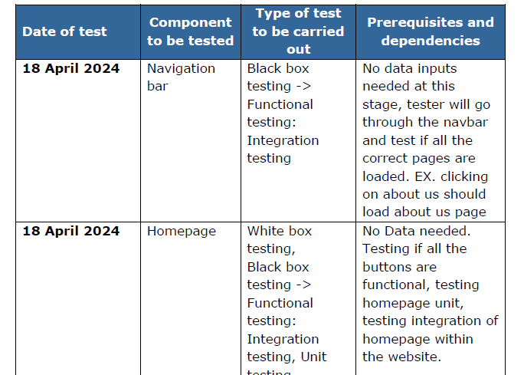
Test strategy
Develop a testing table of what you intend to test and how you will test it, including data you will use as part of the test.
Justify these tests and the data as to why they are good / useful.

Slide 14
TIPS
Can someone else in the group build your solution from your design?
Have you linked each part of your design to your non-functional and functional requirements (use the numbers) and justified how it links / solves that requirement

